Slide 1
Problem Statement
Many renewable energy sources available.
Difficulty to find suitable renewable energy solution for specific location.

Slide 3


INTRODUCING

Slide 4
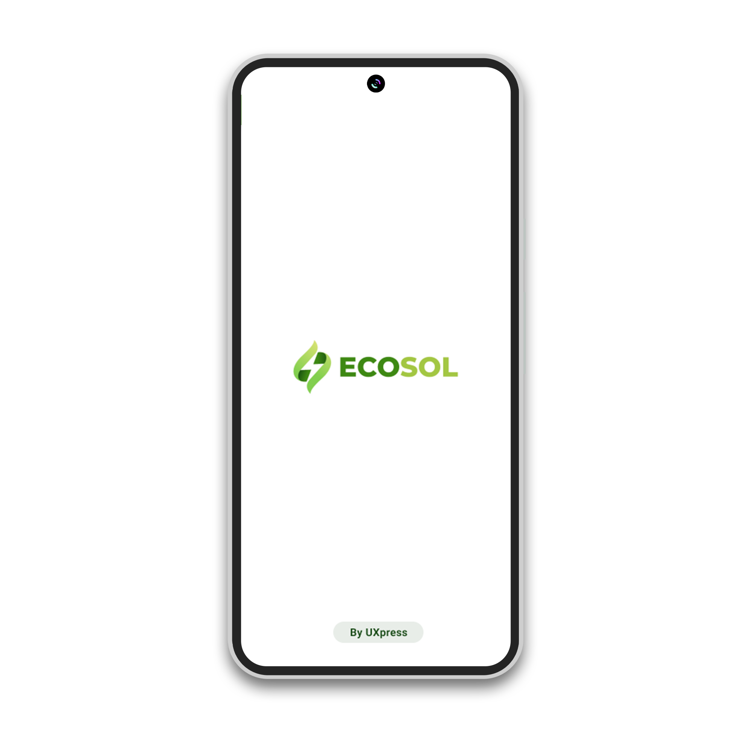
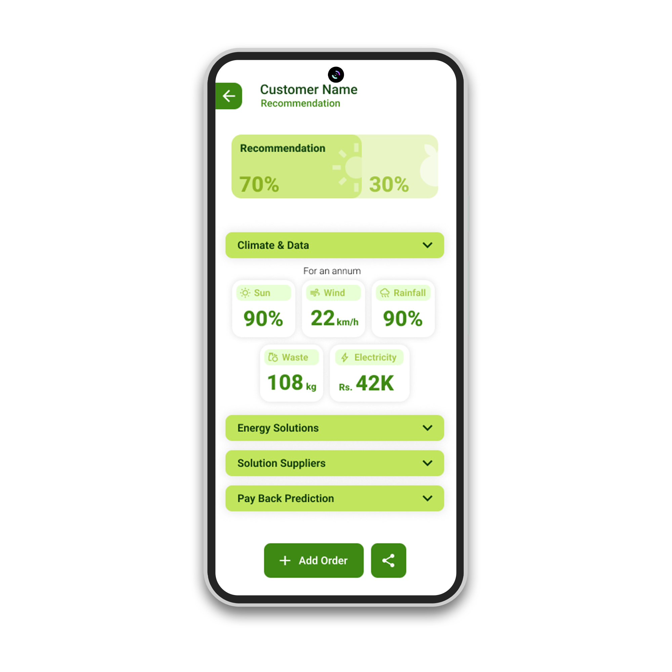
INTRODUCING

Slide 5
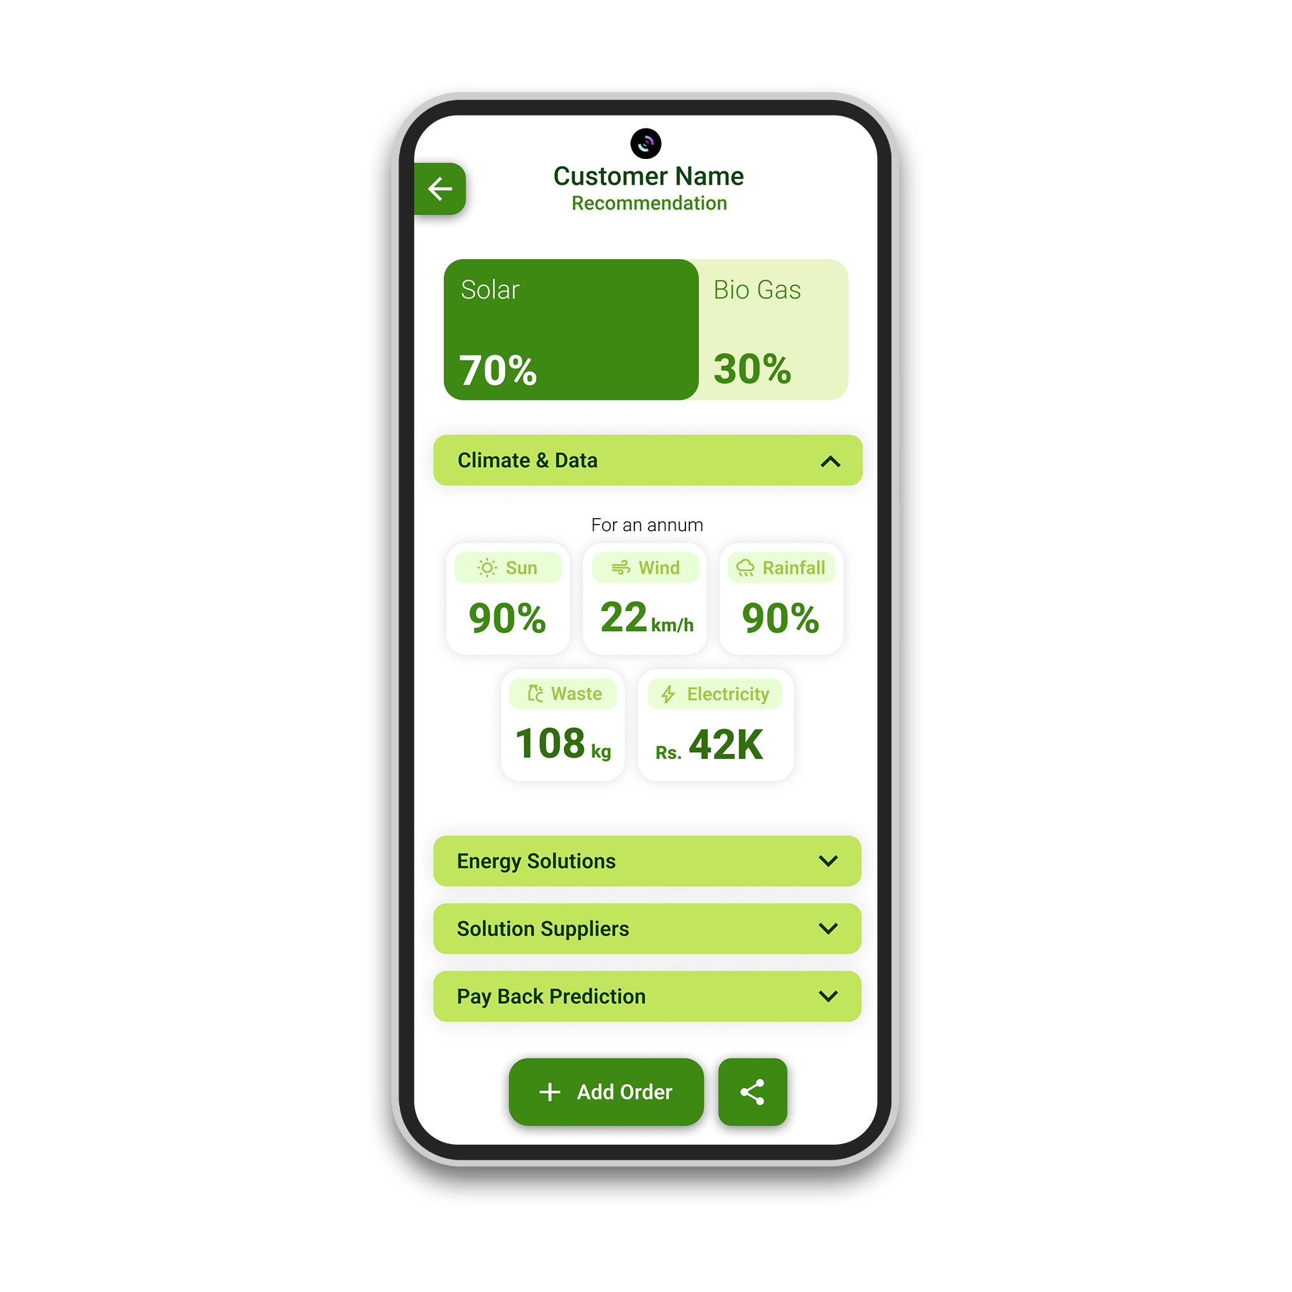
INTRODUCING

Slide 6
What is
?
ECOSOL is a powerful app with user-friendly interfaces and integrated AI to suggest the best possible energy sources for clients seeking clean and sustainable energy by analyzing details like electricity usage, GPS location, food waste amount, and weather app data.

Slide 7
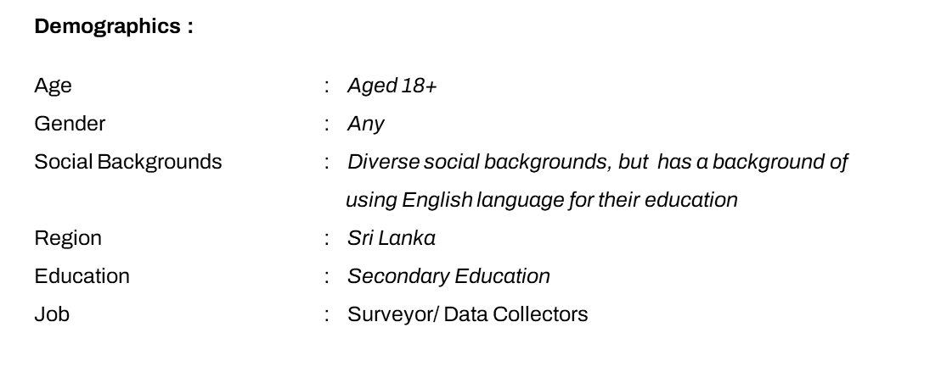
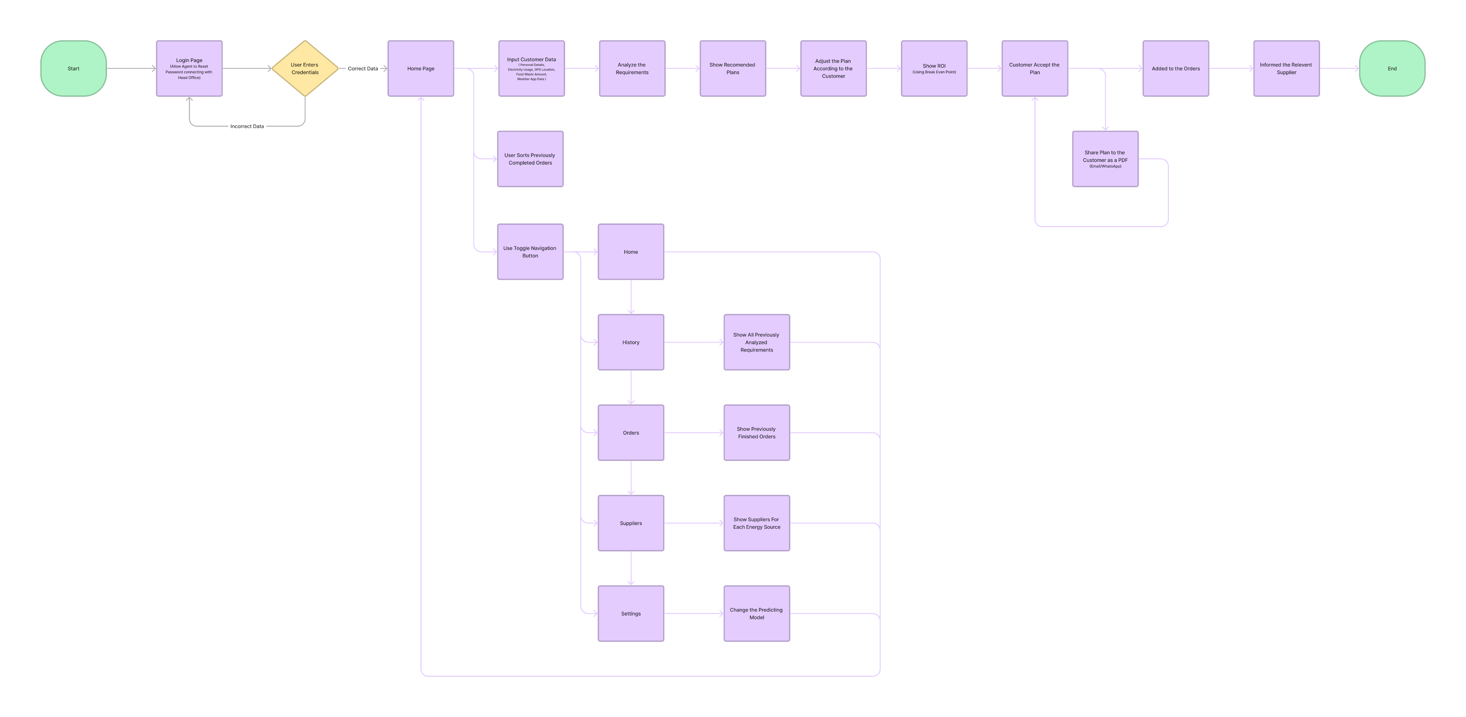
Target Audience Profiling
SMEs Renewable Solution Retailers

Slide 8
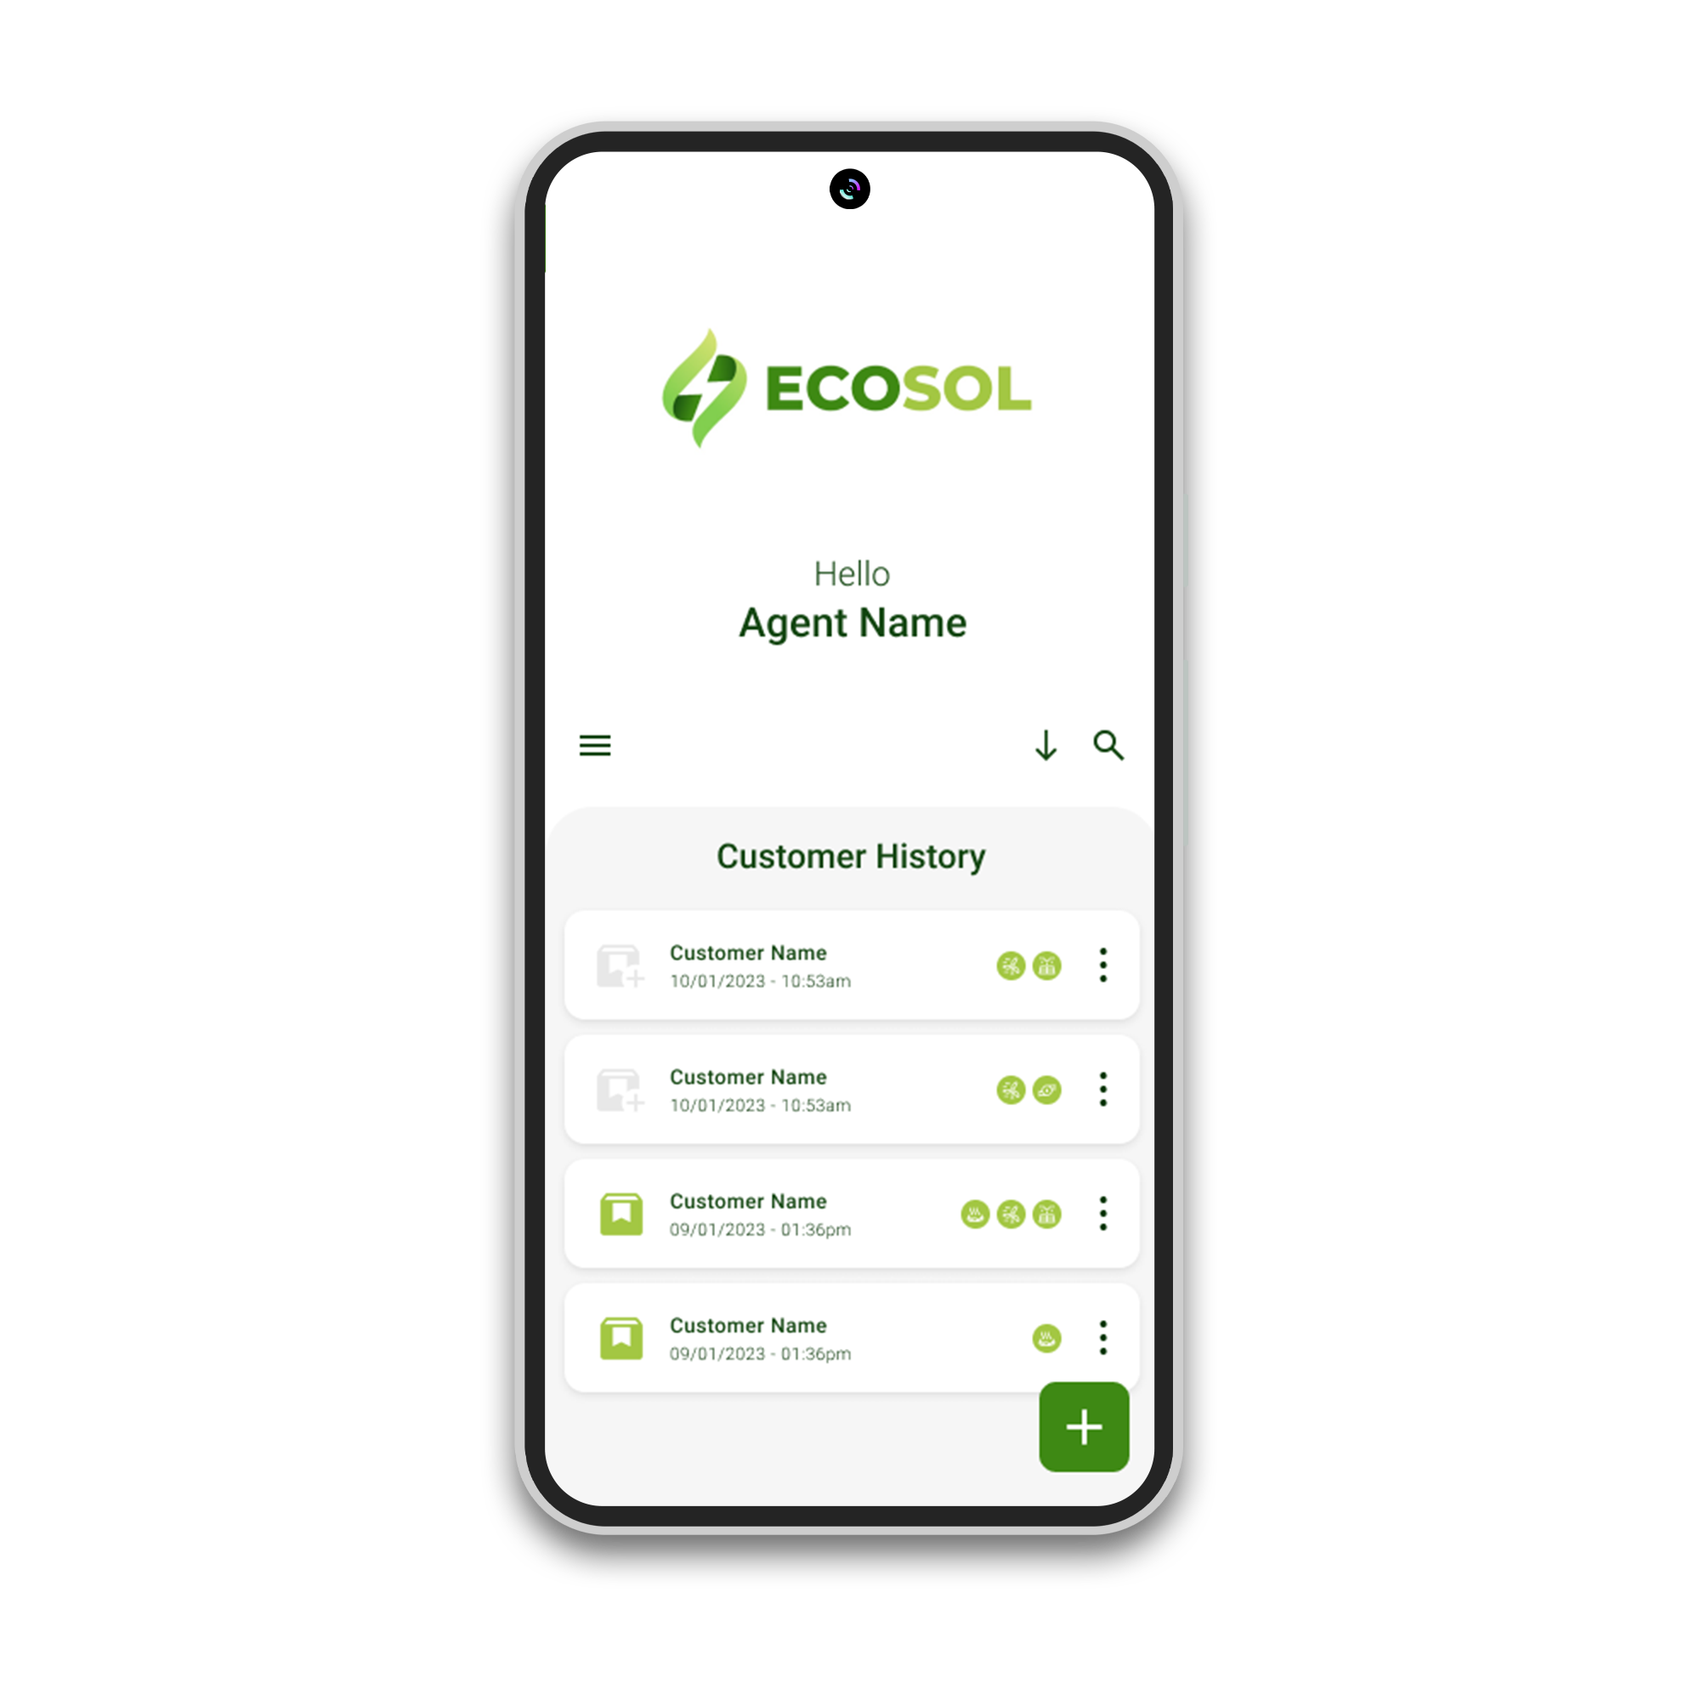
Features of
Recommend the most possible energy sources
Efficiency
Users are able to get the best possible plans according to their environment.
This app can greatly reduce the time and cost
Personalized energy plan
Provide Payback Prediction
The app creates a fully personalized plan for each customer, and the customer can select the most preferred plan and the supplier.
Generate a payback prediction for chosen plan which includes the estimated time to recover the cost.
Place the order
Share Plan as a PDF
This allows to place the order based on a relevant plan.
Share plan as a PDF with relevant customer through Email/ WhatsApp
Artificial Intelligence Integrated
Integrated AI models to perform best suitable recommendations choose the best power plan.

Slide 9

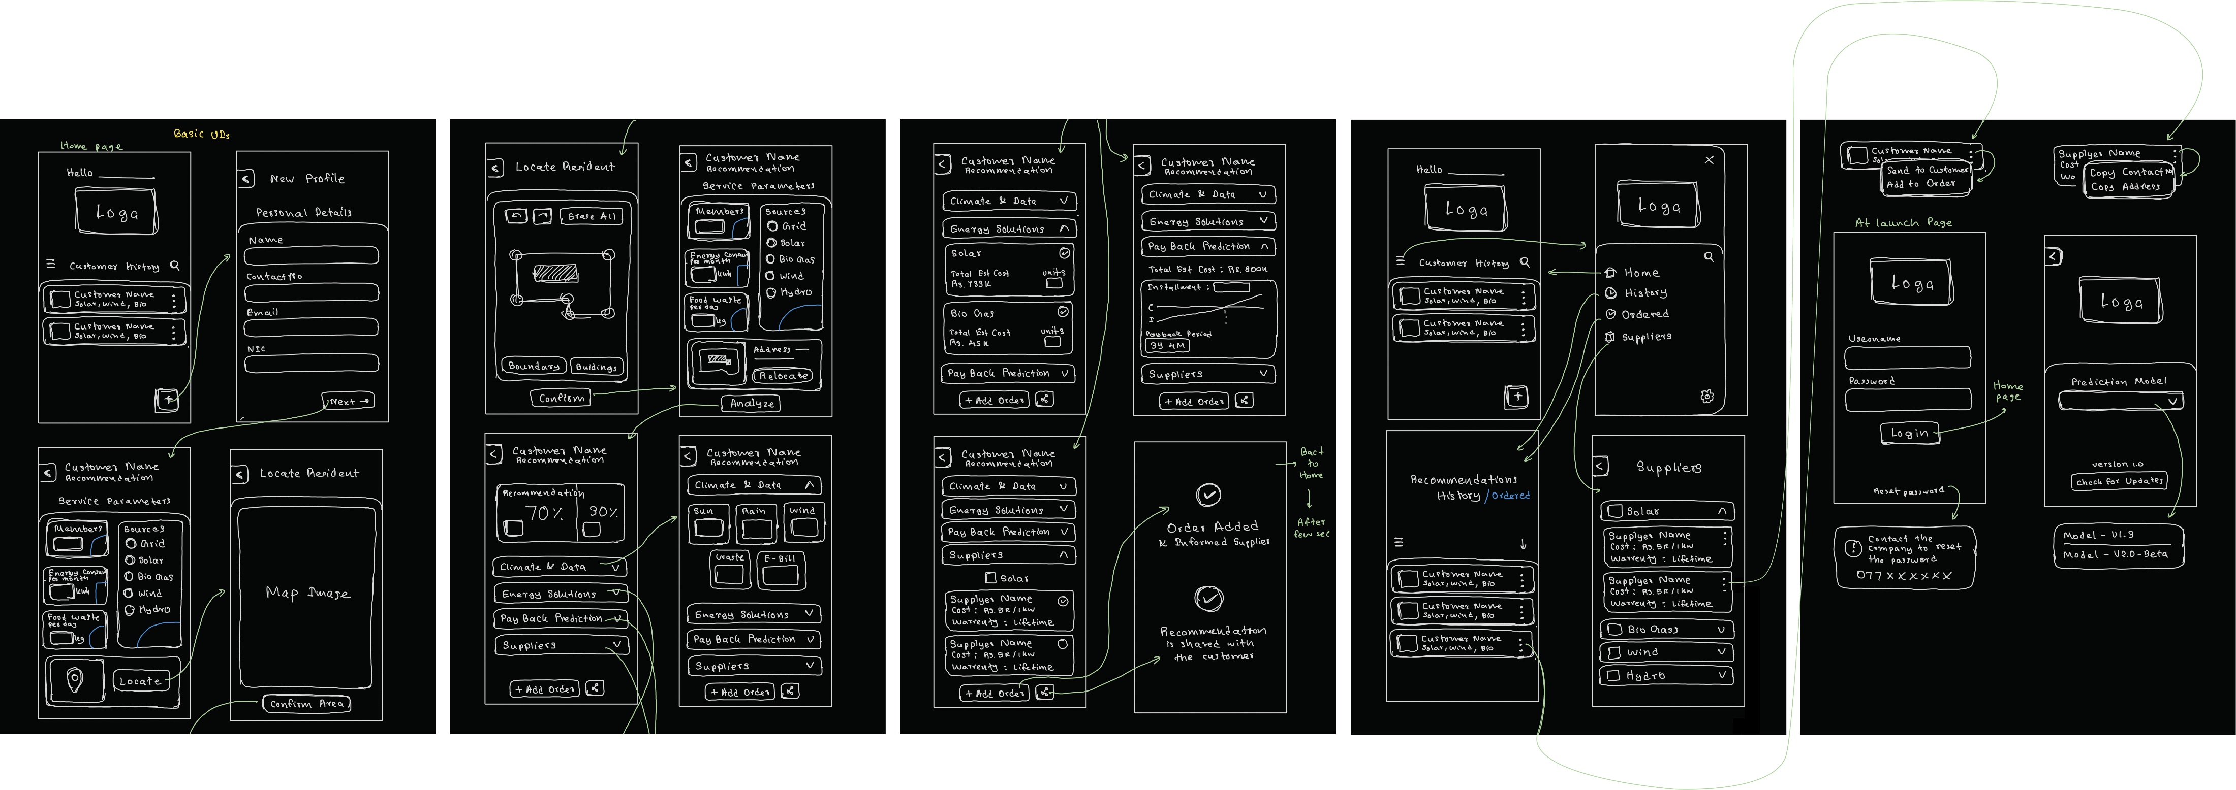
User Flow Diagram
Click here to view on Figma

Slide 10
Wireframe Designs

Slide 11
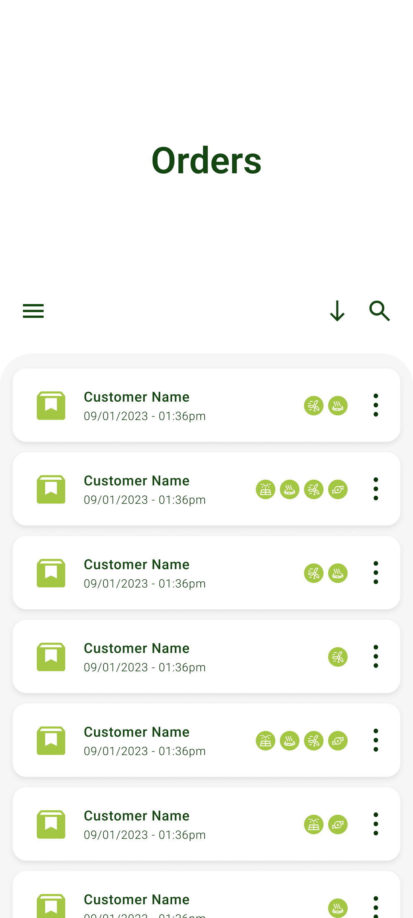
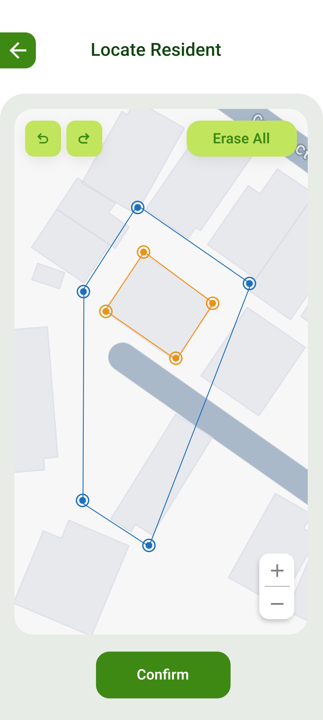
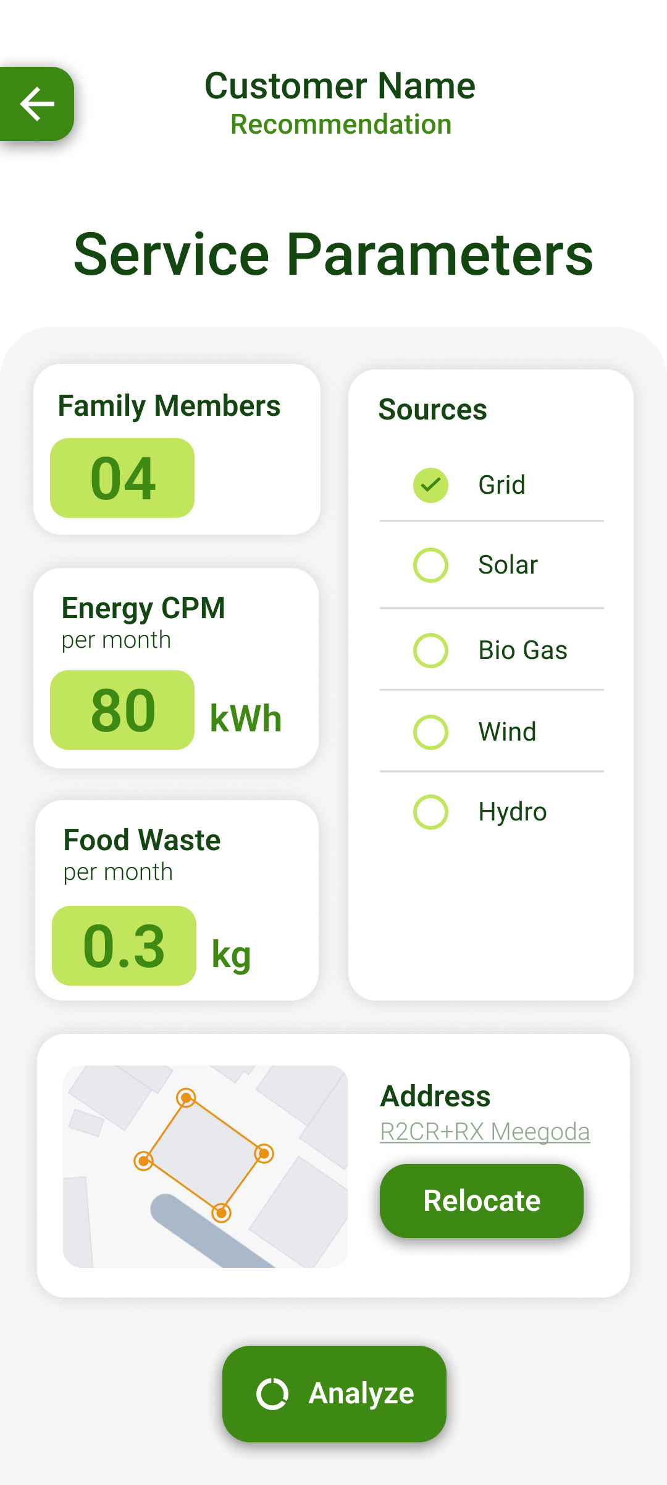
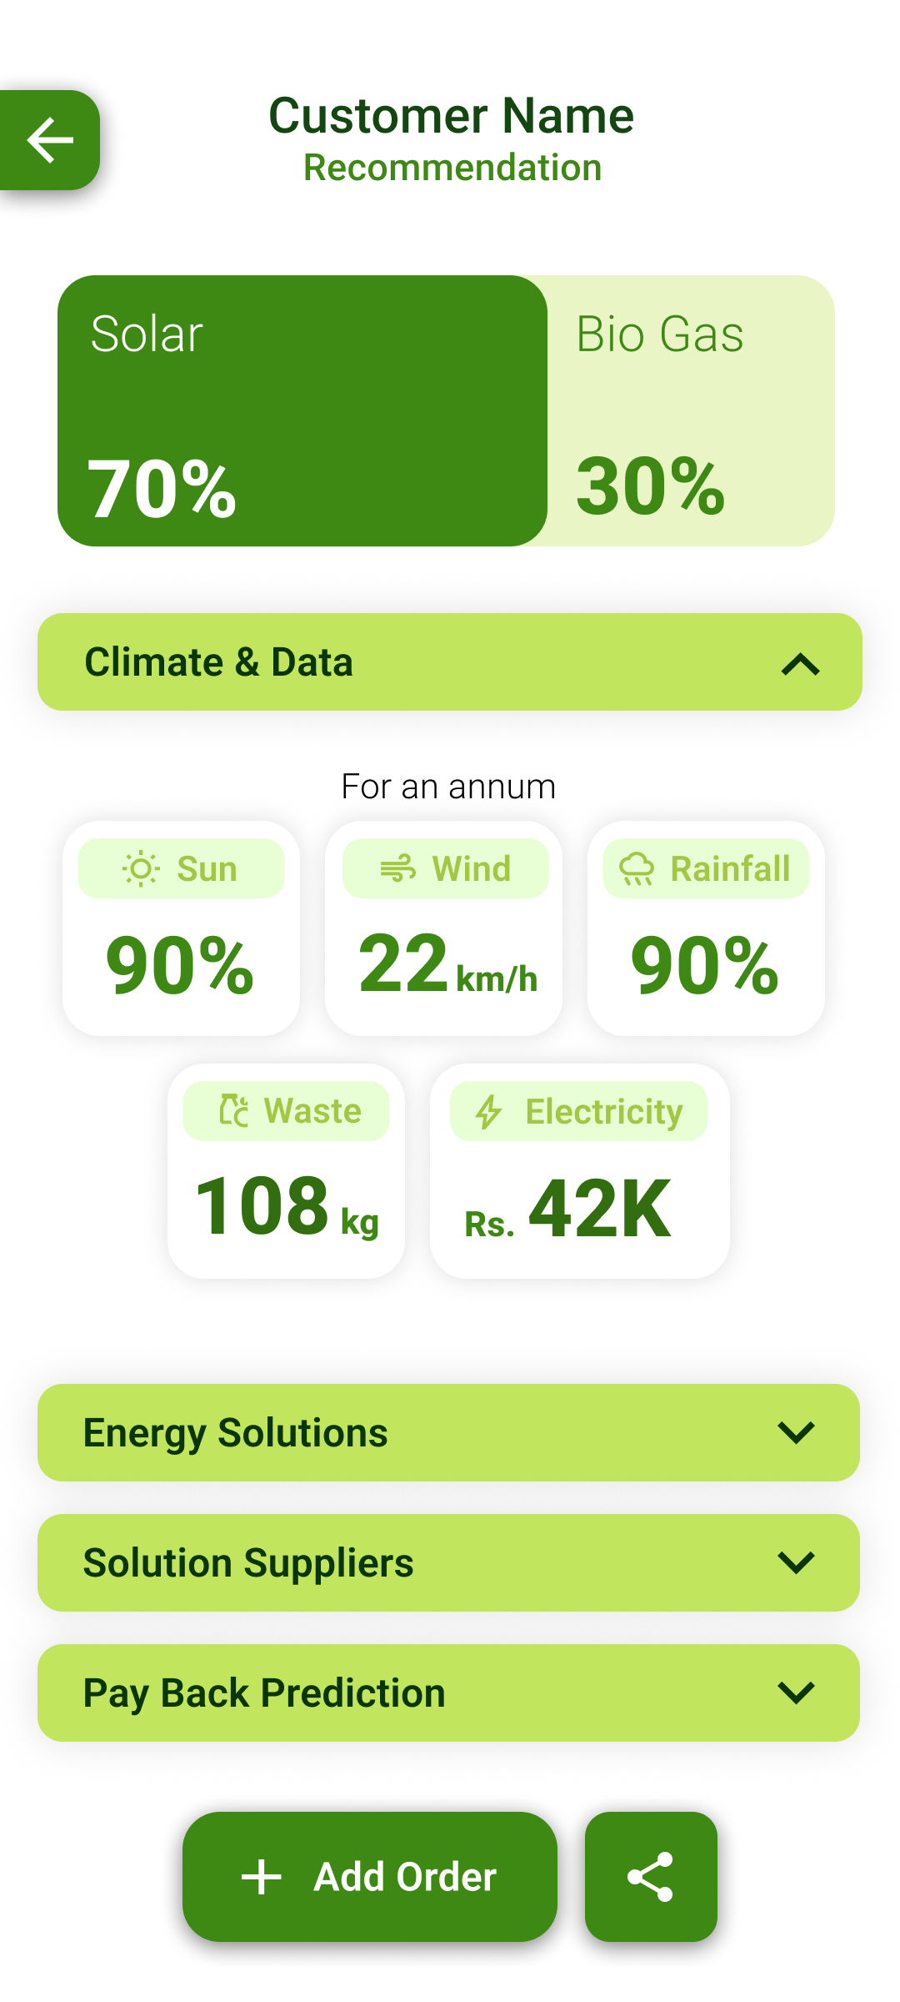

App UI Design

Slide 12
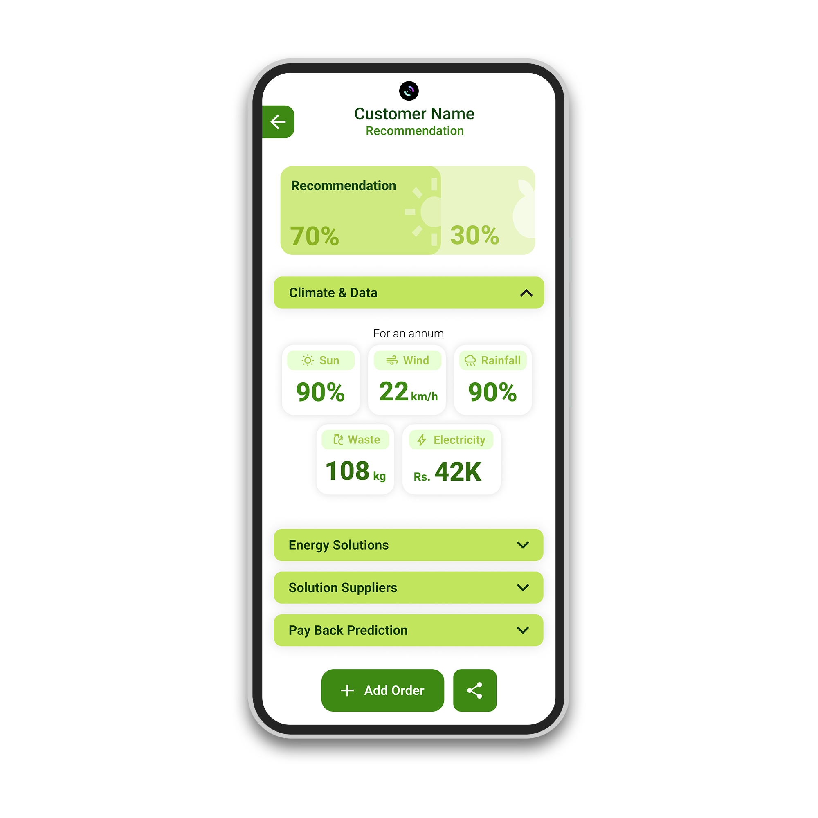
Team Members
01
02
03
04
Vinura Gallage
Dilshan Gamage
Nadeera Udayanga
Shavindu Thushara
University of Sri Jayewardenepura

Slide 13
Thank You!

Slide 14
Thank You!

